Slide 1



Program Assistant
Microsoft Power BI Dashboard Reporting
11 September 2026

Slide 2
HWC-SC Website View Data

Slide 3
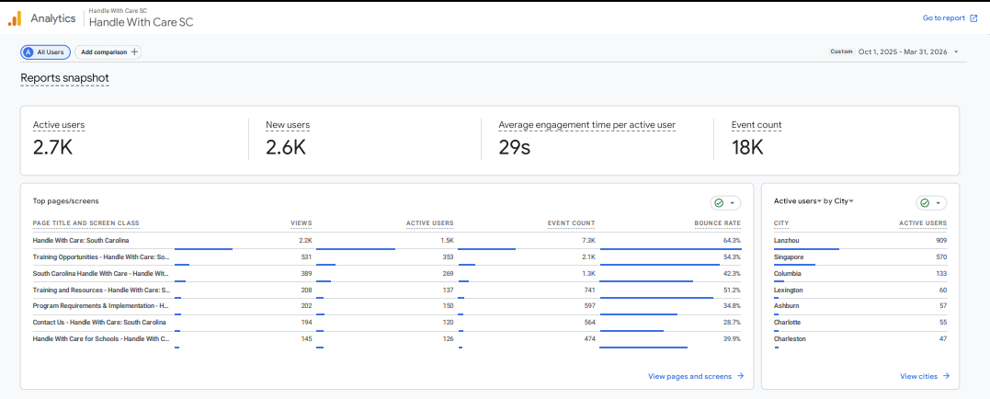
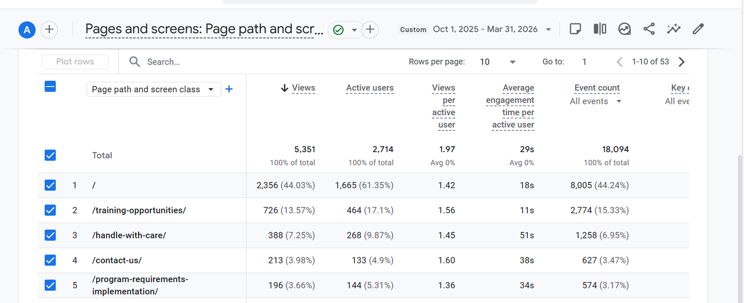
Data Report 1 October 2025 - 31 March 2026

Slide 4
Handle with Care Website Narrative
Since its launch in 2024, the Handle With Care South Carolina (HWC-SC) website has demonstrated strong engagement and reach. Between July 1, 2024, and November 20, 2025, the site recorded over 8,700 total views across its pages, with the main homepage and core program pages leading in traffic. The site attracted more than 4,800 active users, averaging 1.7 views per active user, which indicates that visitors explored multiple resources during their sessions. Engagement time was significant, with users spending an average of 38 minutes per active user on the homepage and even higher times on implementation and FAQ pages, some exceeding 70 minutes, reflecting deep interest in program details. Training and resource pages also saw consistent activity, supporting the program’s goal of equipping schools and agencies with trauma-informed practices. Overall, these metrics show that the HWC-SC website is not only reaching its intended audience but also fostering meaningful engagement, which is critical for advancing the program’s mission statewide.
Top-performing pages highlight user priorities. The homepage and the “Handle With Care” overview page together accounted for the largest share of views, confirming strong interest in understanding the program’s purpose. The “Training Opportunities” page ranked second, showing that visitors are actively seeking professional development resources. Pages such as “Program Requirements & Implementation” and “Contact Us” had some of the highest engagement times—over 70 minutes in some cases—indicating that users are deeply reviewing guidance for implementation and connecting with program staff. This pattern suggests that stakeholders are not only learning about the program but also taking steps toward adoption and collaboration.

Slide 5
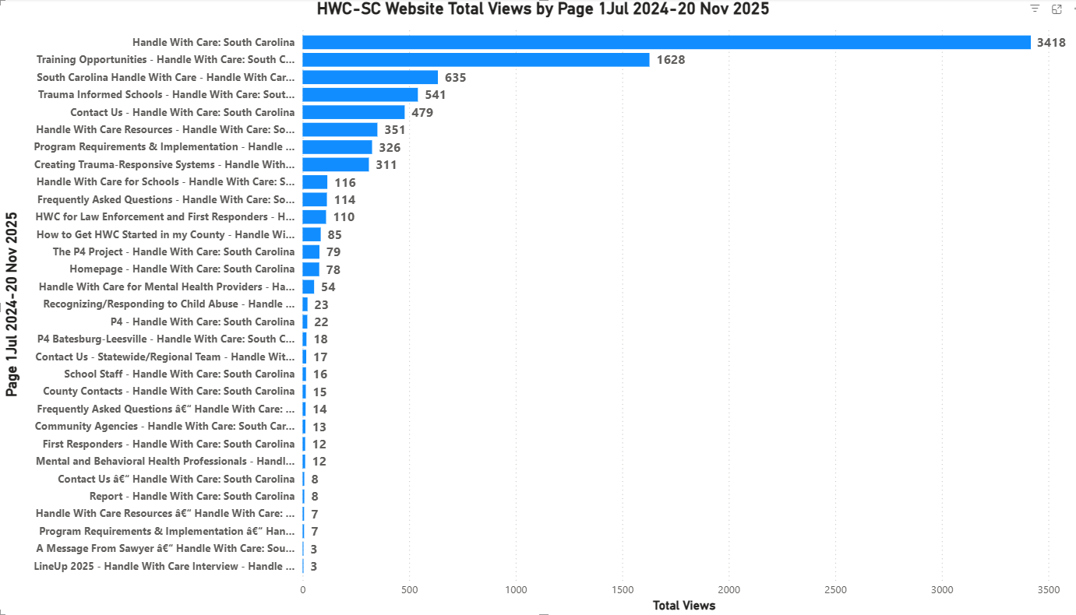

Slide 6
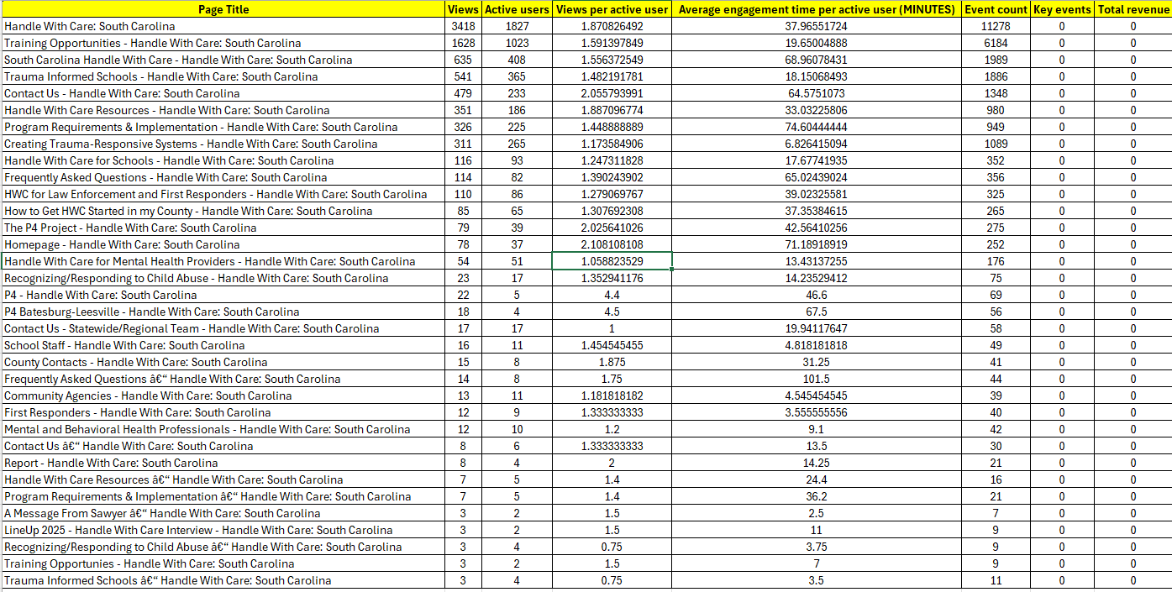
Data Report 1 July 2024 - 20 November 2025

Slide 7
South Carolina Crime Involving Firearms Data

Slide 8
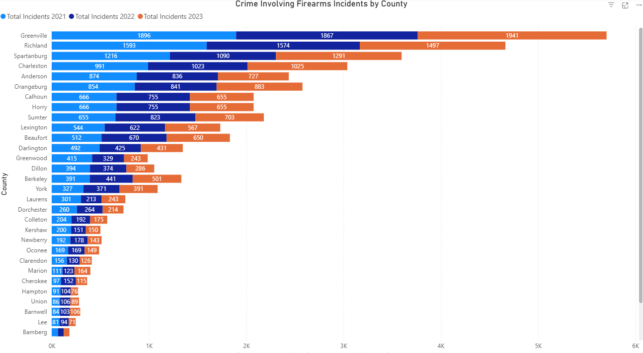
Crime Involving Firearms Incidents Data (by County)

Slide 9
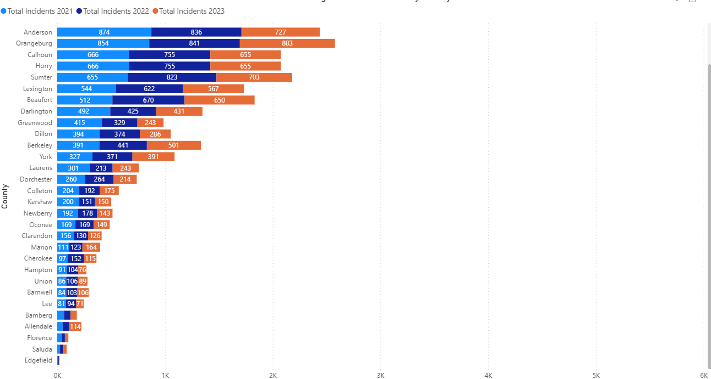
County Crime Involving Firearms Incidents Data (by County)

Slide 10
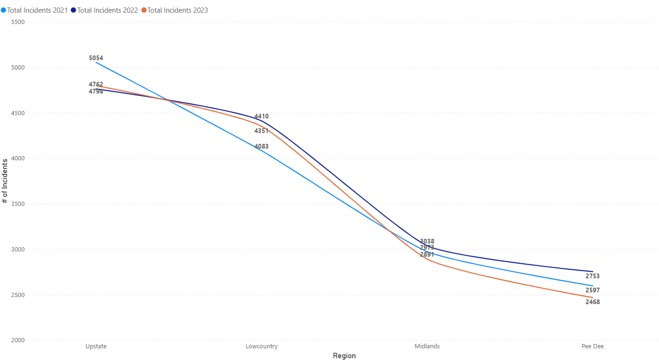
Crime Involving Firearms Incidents Data (Year/Region)

Slide 11
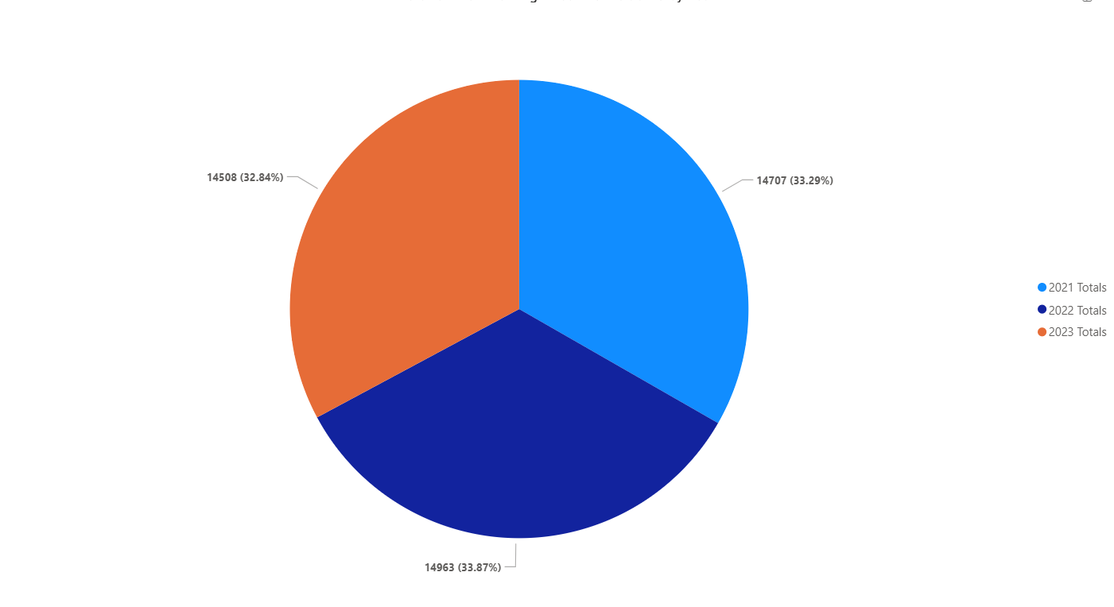
Crime Involving Firearms Incidents Data (Year Totals)

Slide 12

Handle with Care - South Carolina
Quarterly Onboarding Training Report

Slide 13
HWC-SC Quarterly Onboarding Training Attended
June 2026 - Total: ?
PEE DEE

Slide 14
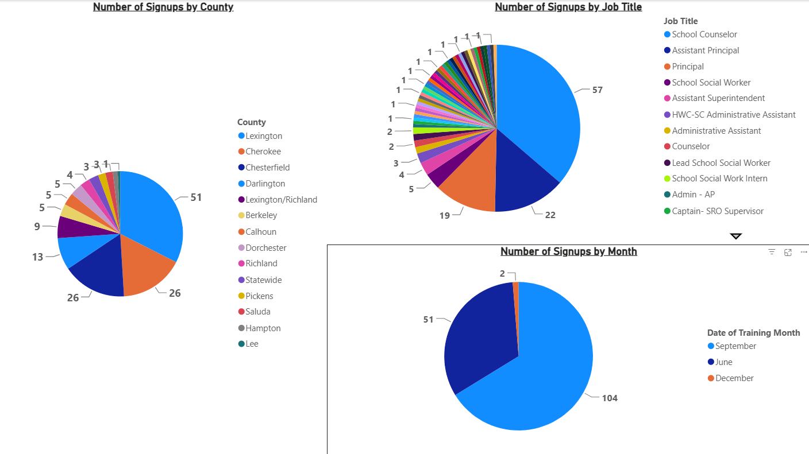
HWC-SC Quarterly Onboarding Training Signups #s - Total: 157 (2 September 2026)
PEE DEE

Slide 15
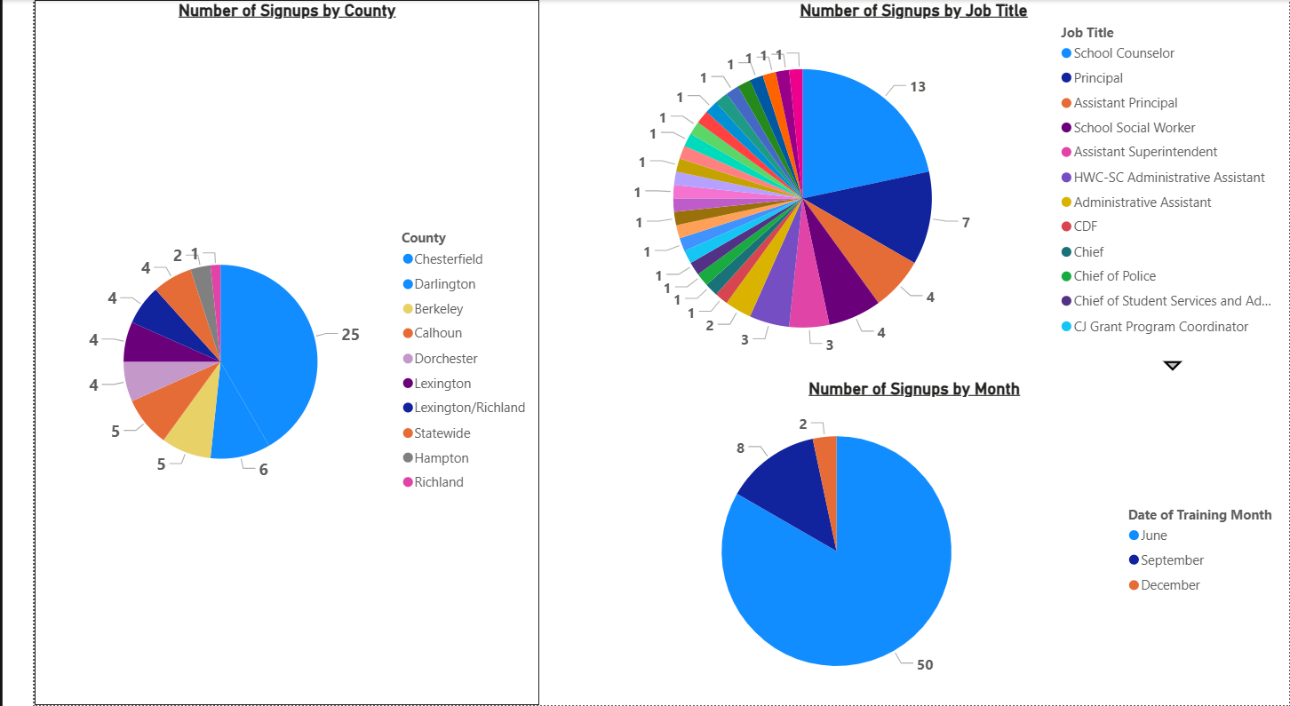
HWC-SC Quarterly Onboarding Training Signups #s - Total: 60 (June 2026)
PEE DEE

Slide 16
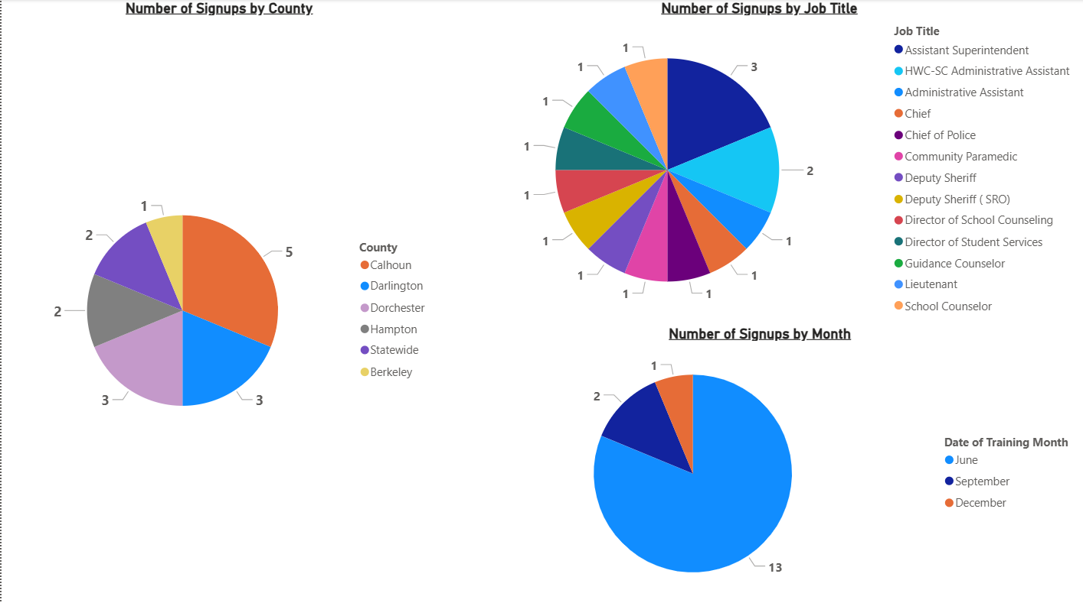
HWC-SC Quarterly Onboarding Training Signups #s - Total: 16 (27 April 2026)
PEE DEE

Slide 17
HWC-SC Quarterly Onboarding Training Attended
September 2026 - Total: ?
PEE DEE

Slide 18
HWC-SC Quarterly Onboarding Training Attended
December 2026 - Total: ?
PEE DEE

Slide 19
Handle with Care - South Carolina
Regional Training Reporting

Slide 20
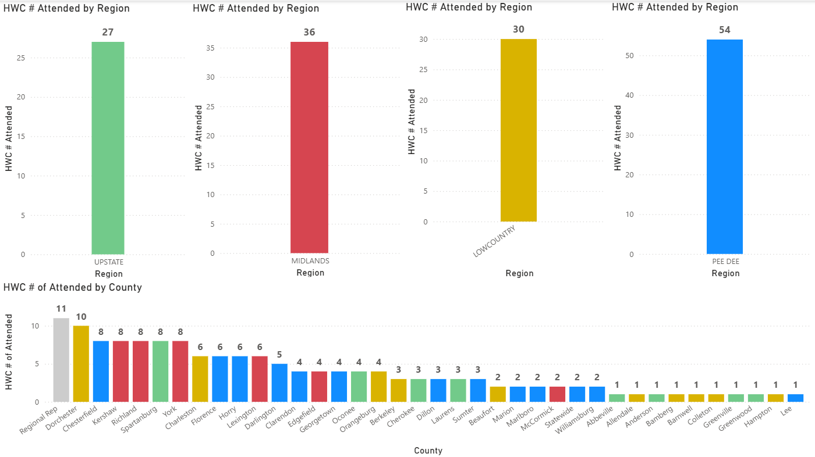
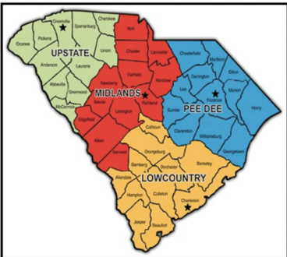
HWC Regional Training Attended #s - Total: 147
PEE DEE

Slide 21
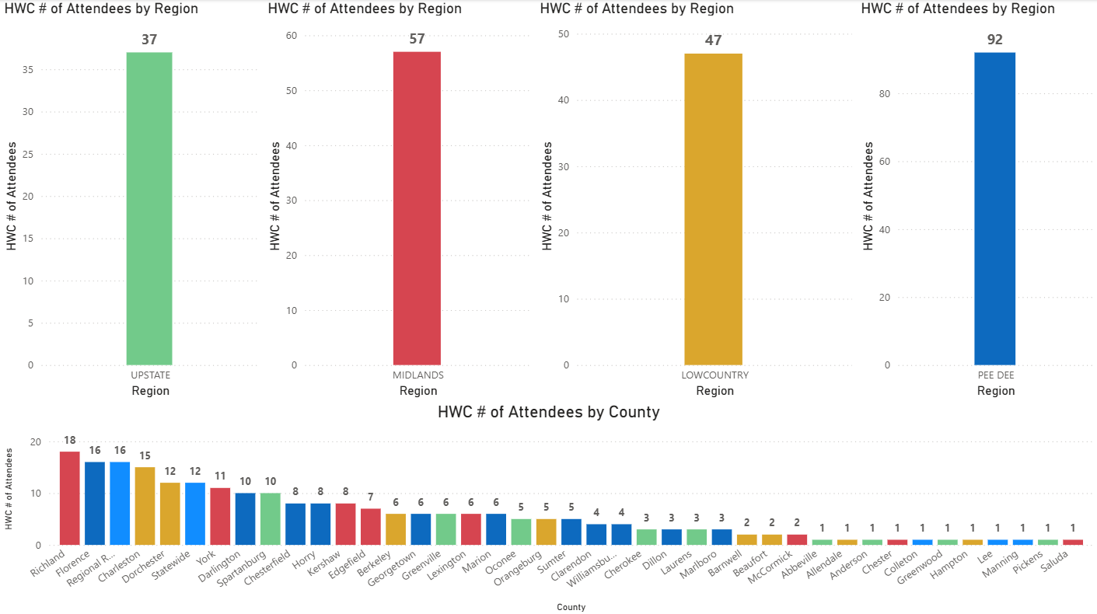
HWC Regional Training Google Forms Signup Attendees Request
as of 24 November 2025

Slide 22
HWC-SC Notifications County Reporting

Slide 23
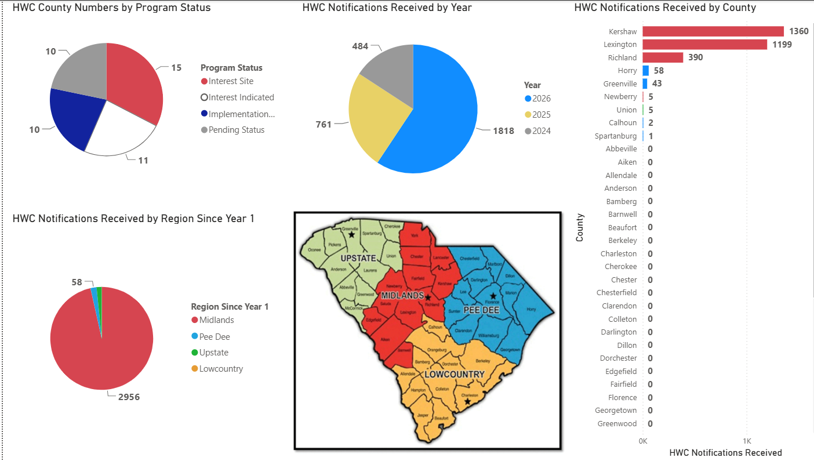
HWC Notifications Monthly Reported by County POC - Current

Slide 24
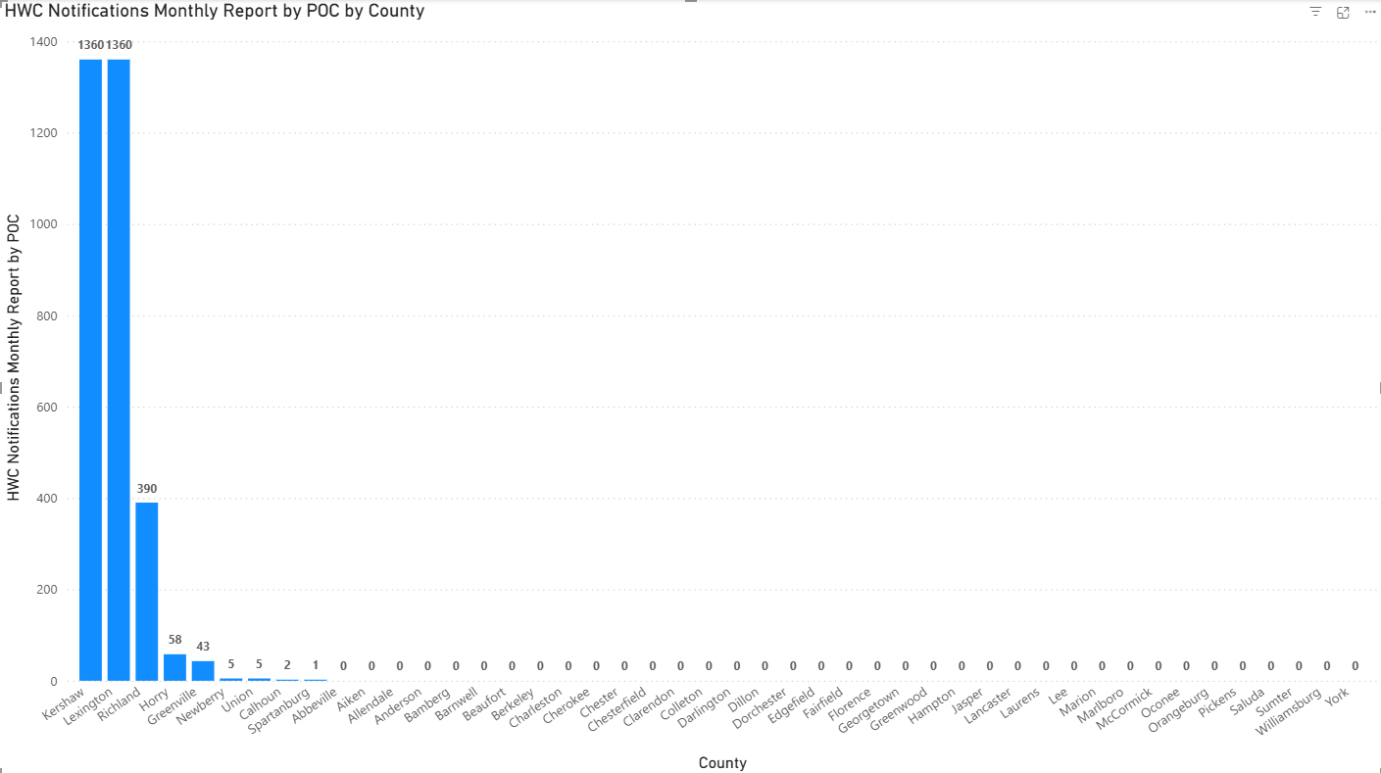
HWC Notifications Monthly Reported by County POC - Current

Slide 25
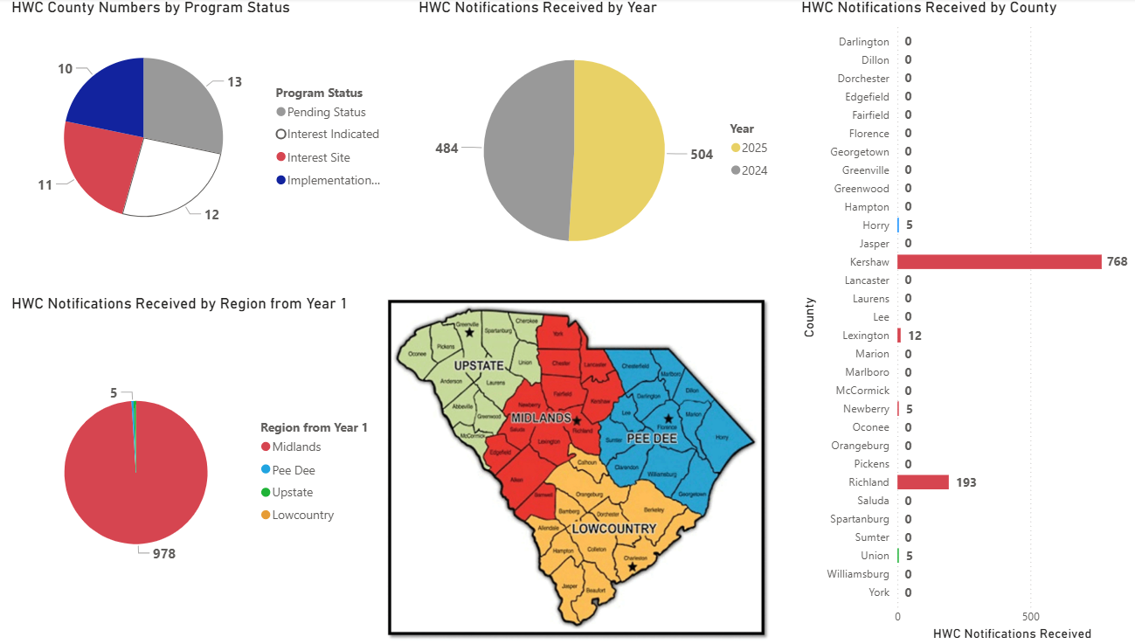
HWC Notifications Monthly Reported by County - 1 October 2025

Slide 26
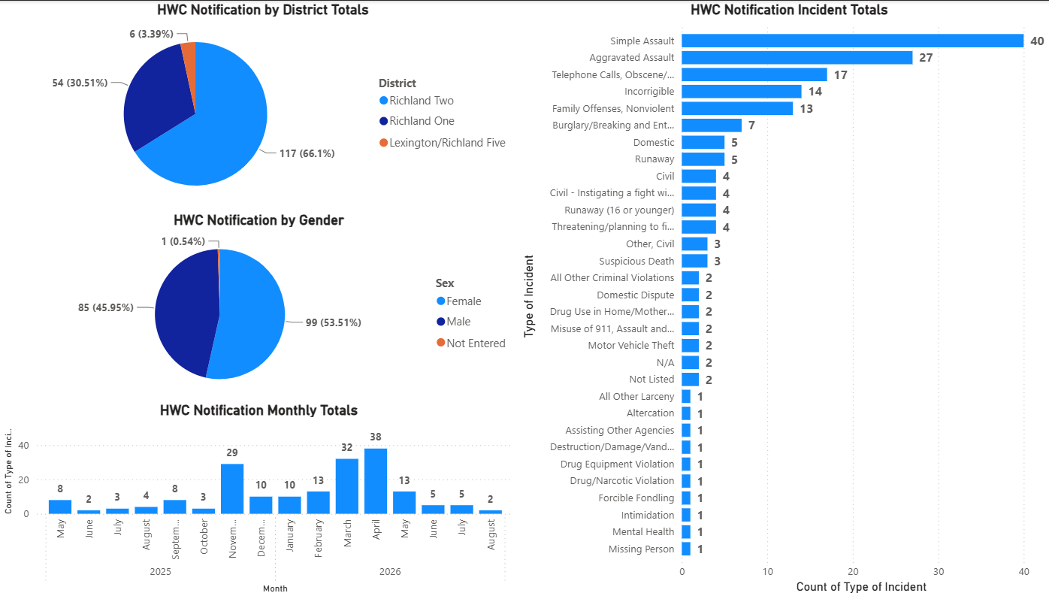
Richland County SD HWC Notifications (Current)

Slide 27
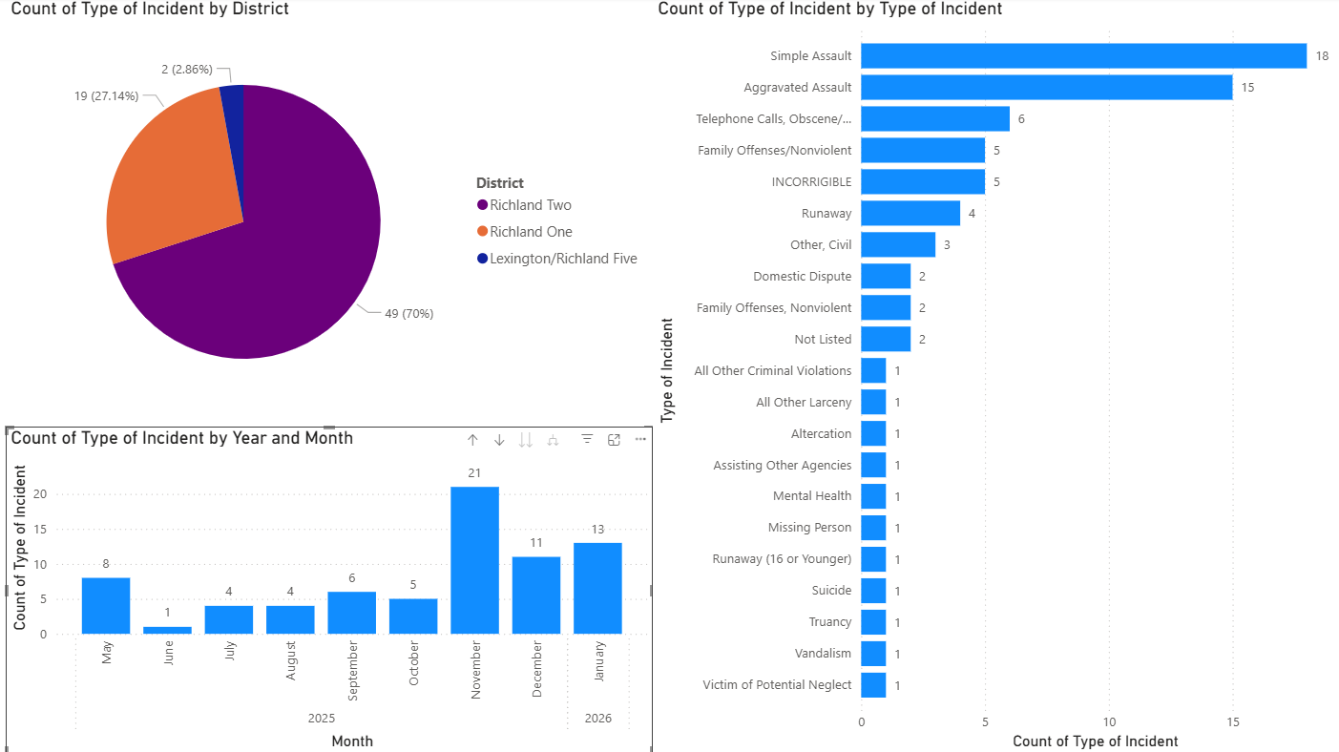
Richland County SD HWC Notifications (Oct 2024)

Slide 28
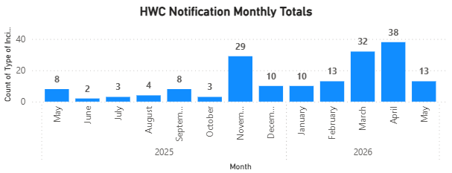
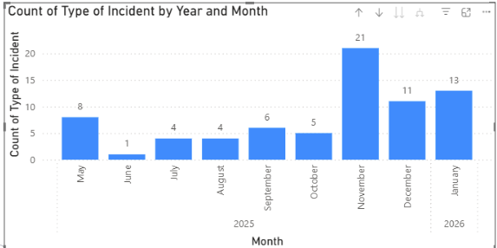
Richland County SD HWC Notifications Reporting
As of 3 June 2026
As of October 2024

Slide 29
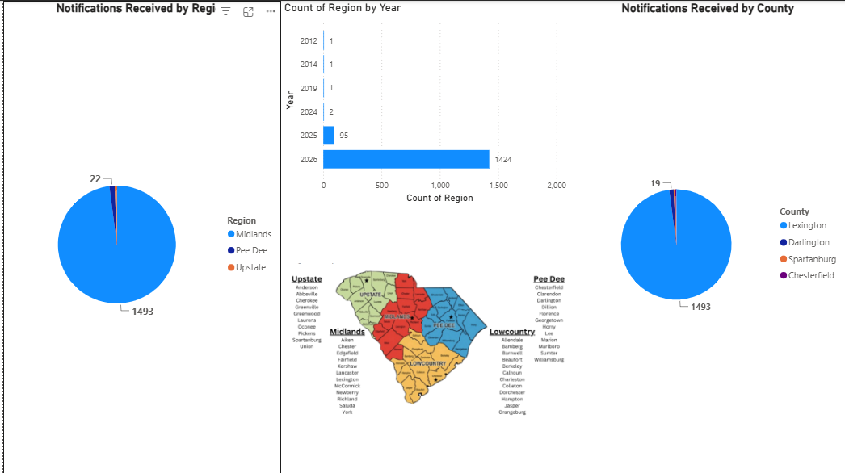
HWC County JotForm QR Code Notifications Current

Slide 30
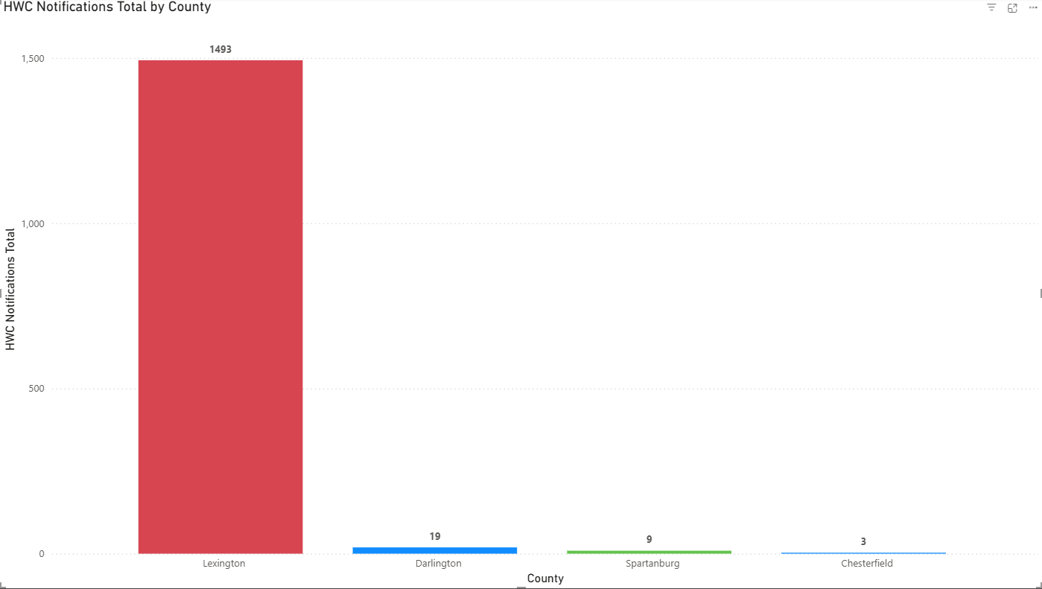
HWC County JotForm QR Code Notifications Current

Slide 31
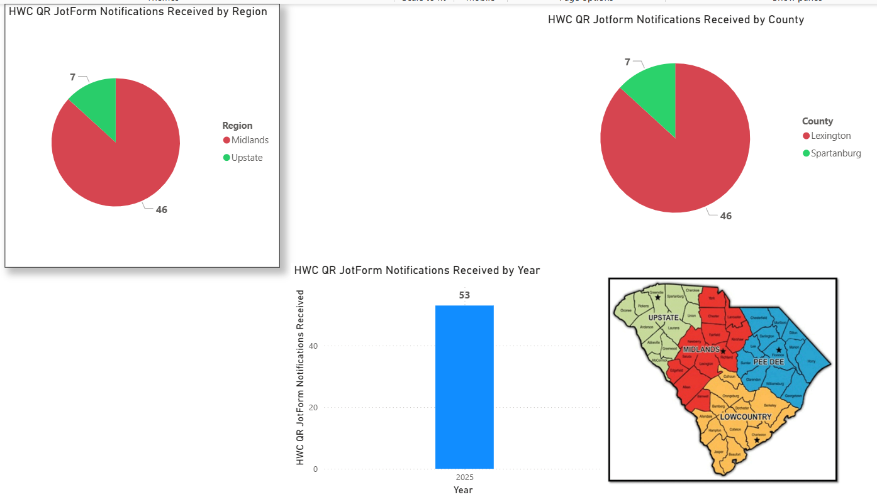
HWC County JotForm QR Code Notifications
1 August 2025

Slide 32
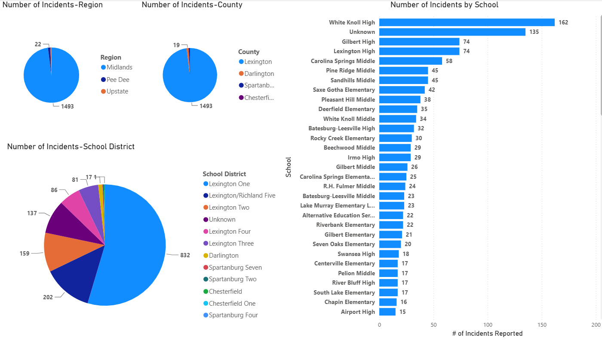
HWC-SC JotForm QR Code Notifications Snapshot-Extracted
Current

Slide 33
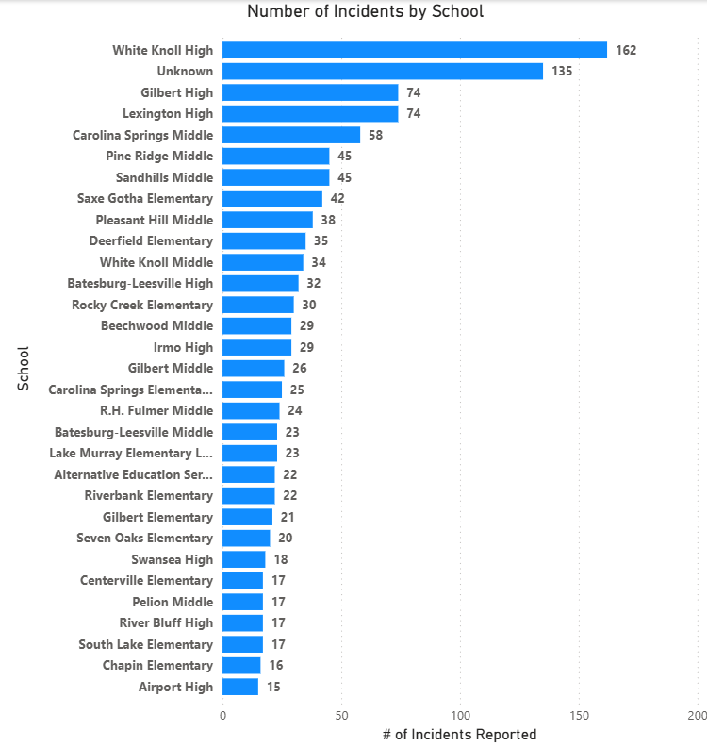
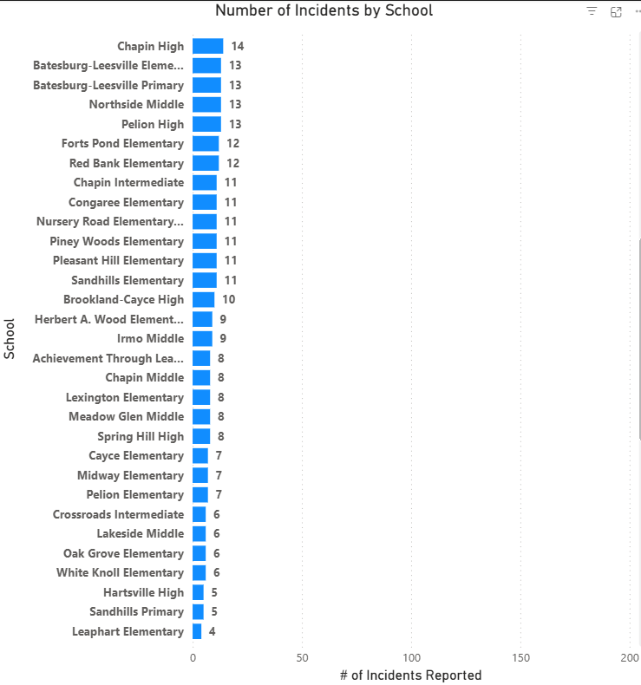
HWC-SC JotForm QR Code Notifications Snapshot-Extracted
Current

Slide 34
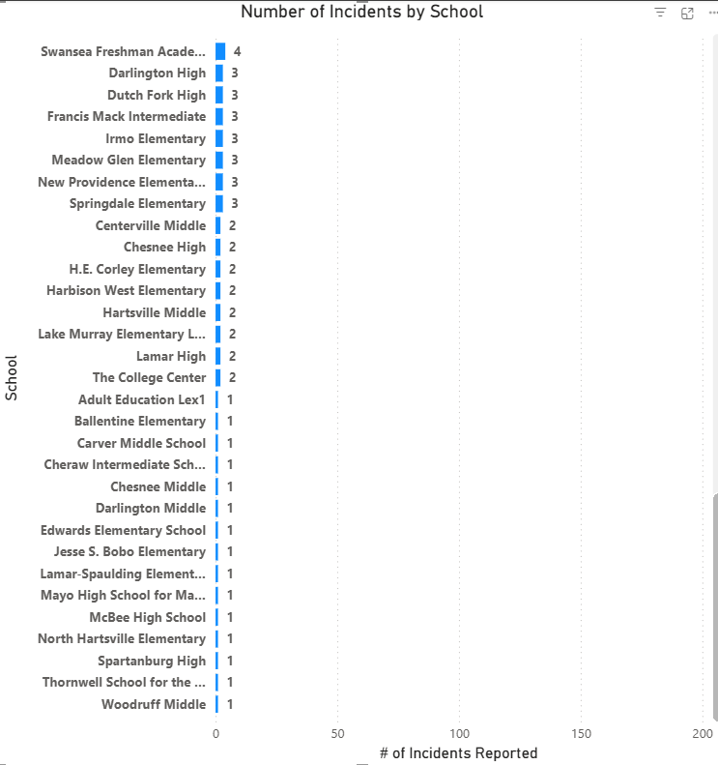
HWC-SC JotForm QR Code Notifications Snapshot-Extracted
Current

Slide 35
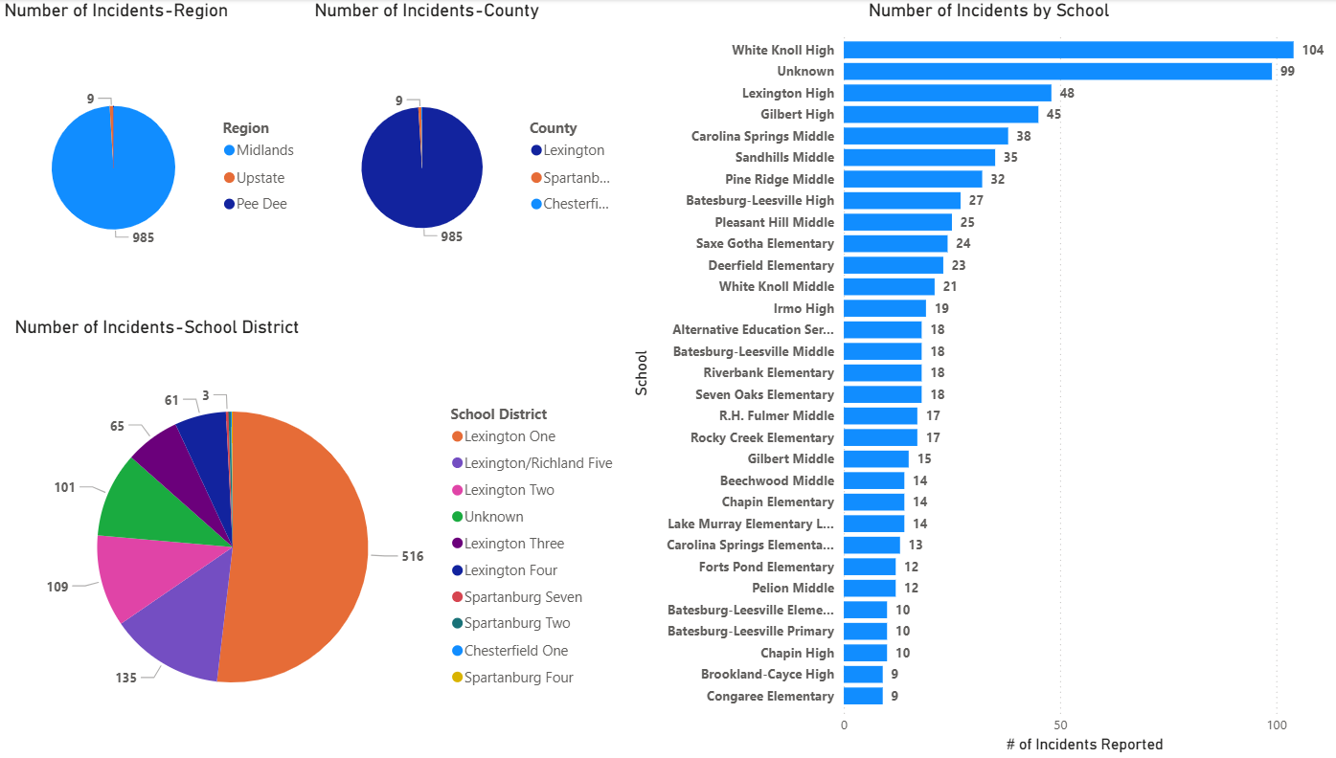
HWC-SC JotForm QR Code Notifications Snapshot-Extracted
30 April 2026

Slide 36
Program Purchases Reporting

Slide 37
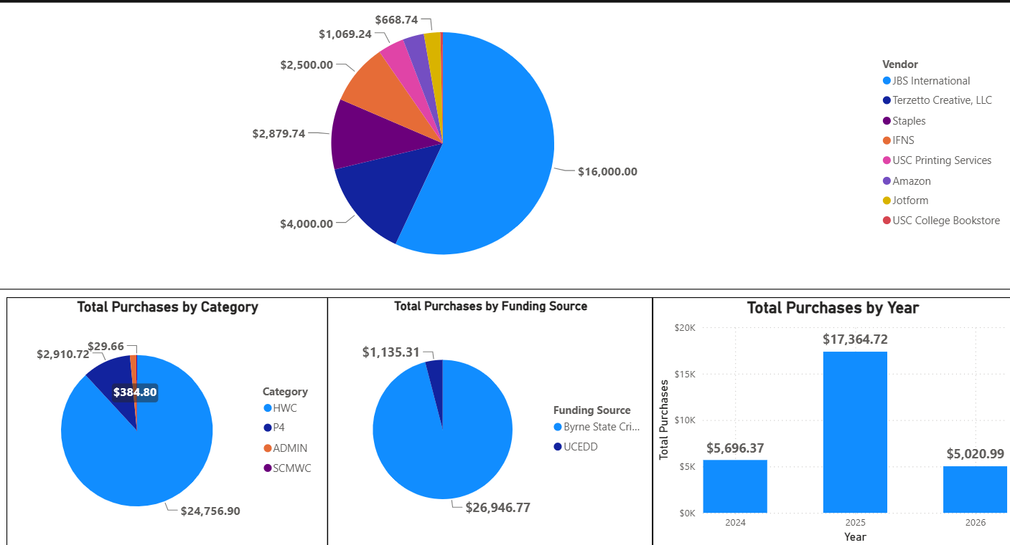
Purchases Year 2 & Year 3 Combined (Current)

Slide 38
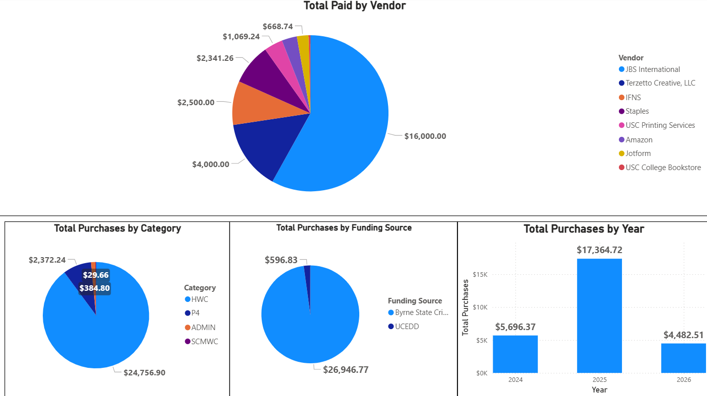
Purchases Year 2 & Year 3 Combined

Slide 39
Employee Travel Reporting

Slide 40
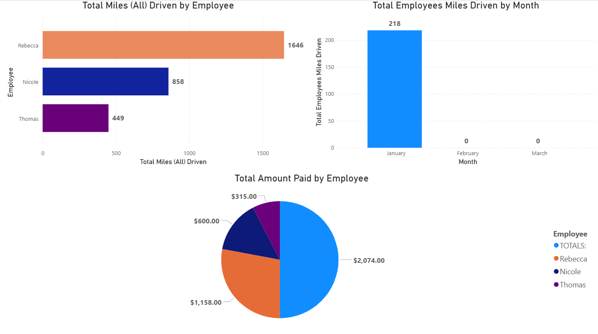
Employee Mileage Reimbursement Year 3
(October 2025-September 2026)

Slide 41
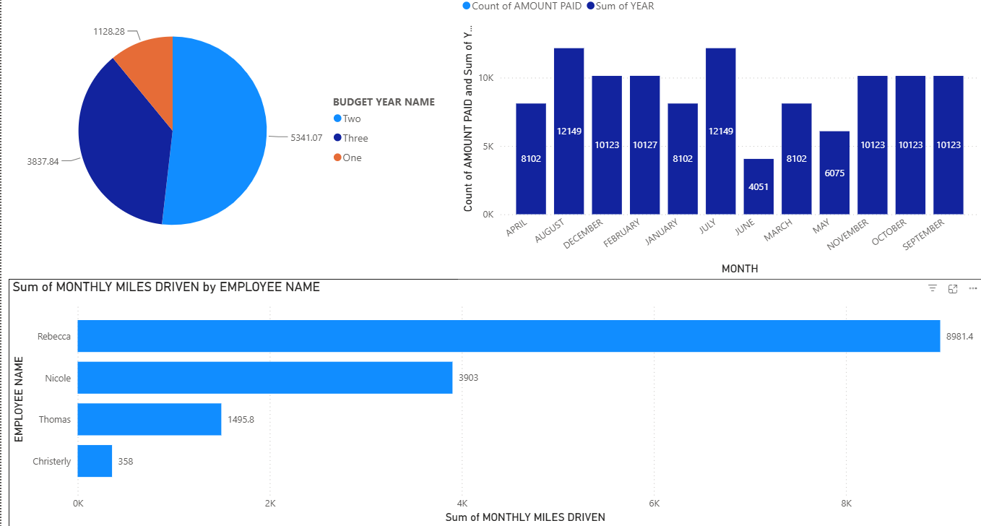
Employee Mileage Reimbursement Year 3
(October 2025-September 2026)

Slide 42
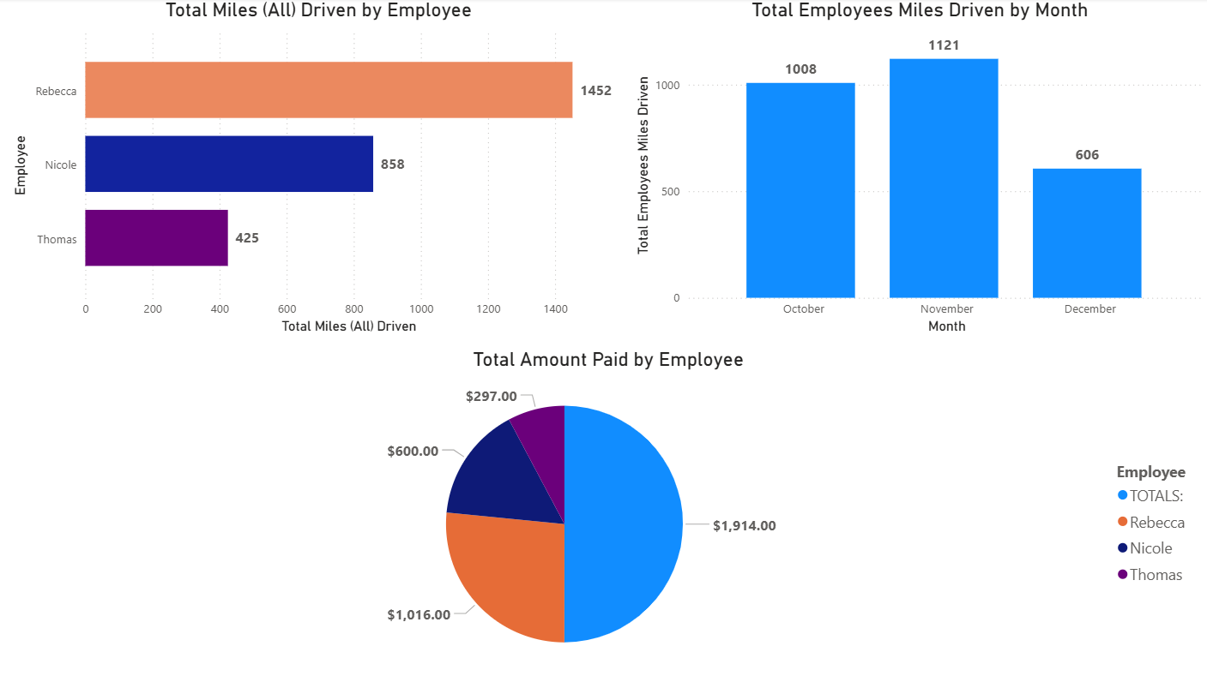
Employee Mileage Reimbursement Year 3
(October 2025-September 2026)

Slide 43
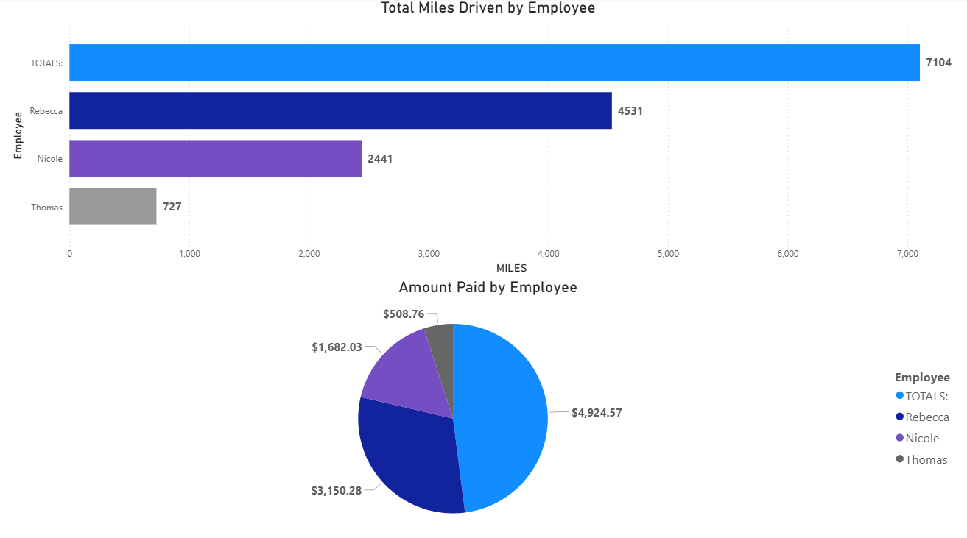
Employee Mileage Reimbursement Year 2
(October 2024-September 2025)

